Slide 1
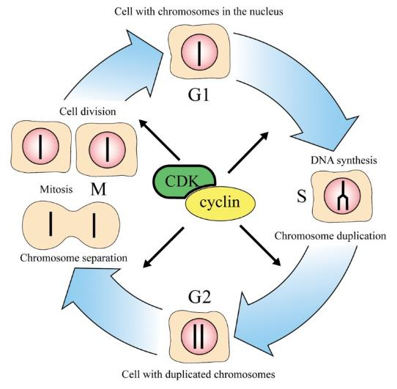
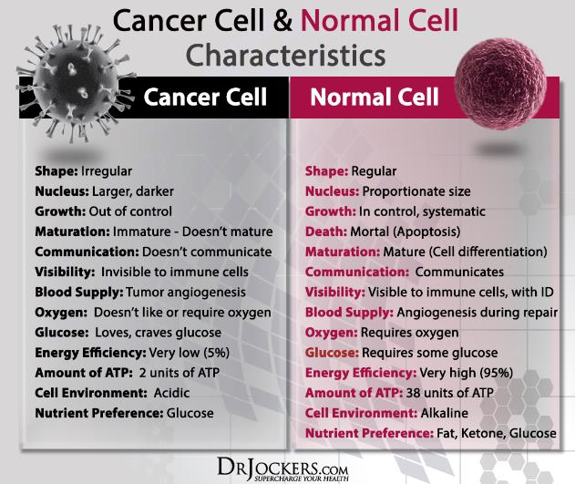
丁明孝 王喜忠 张传茂 陈建国 主编
细胞生物学（第5版）
第十三章
细胞增殖调控与癌细胞
Notes:
http://www.nobelprize.org/nobel_prizes/medicine/laureates/2001/press.html
The different phases of the cell cycle. In the first phase (G1) the cell grows. When it has reached a certain size it enters the phase of DNA-synthesis (S) where the chromosomes are duplicated. During the next phase (G2) the cell prepares itself for division. During mitosis (M) the chromosomes are separated and segregated to the daughter cells, which thereby get exactly the same chromosome set up. The cells are then back in G1 and the cell cycle is completed.
http://drjockers.com/the-difference-between-normal-and-cancer-cells/

Slide 2
本章主要内容
01
细胞增殖调控
02
癌细胞

Slide 3
细胞增殖调控
第一节
MPF的发现及其作用
p34^{cdc2}激酶的发现及其与MPF的关系
周期蛋白
CDK和CDK抑制因子
细胞周期运转调控
其他因素在细胞周期调控中的作用

Slide 4
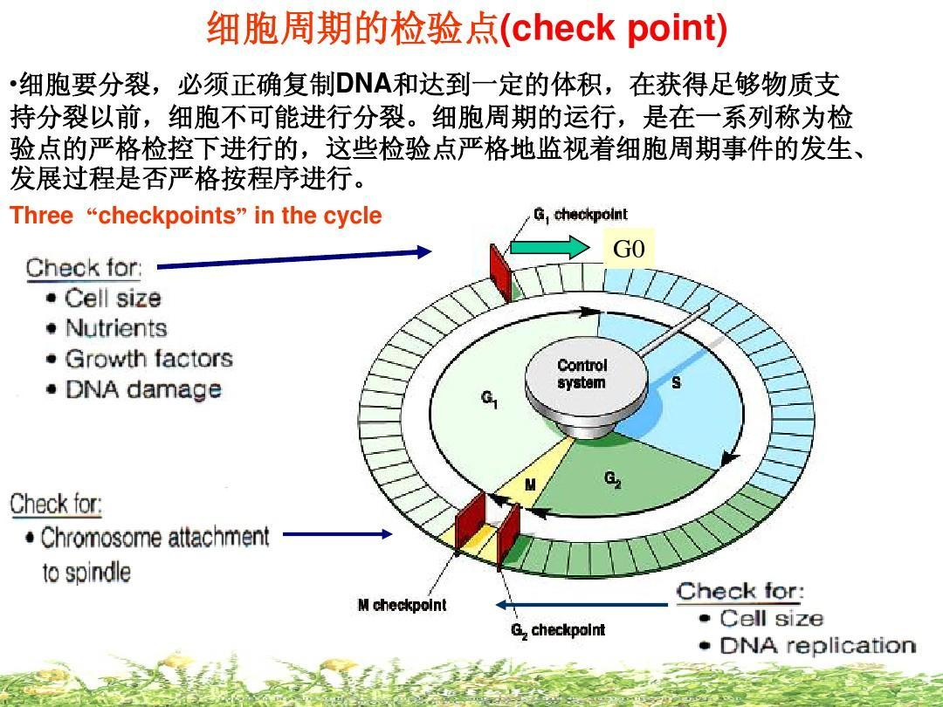
细胞周期检验点(check point)是细胞周期调控的一种机制，主要是确保周期每一时相事件有序、全部完成并与外界环境因素相联系。

Slide 5
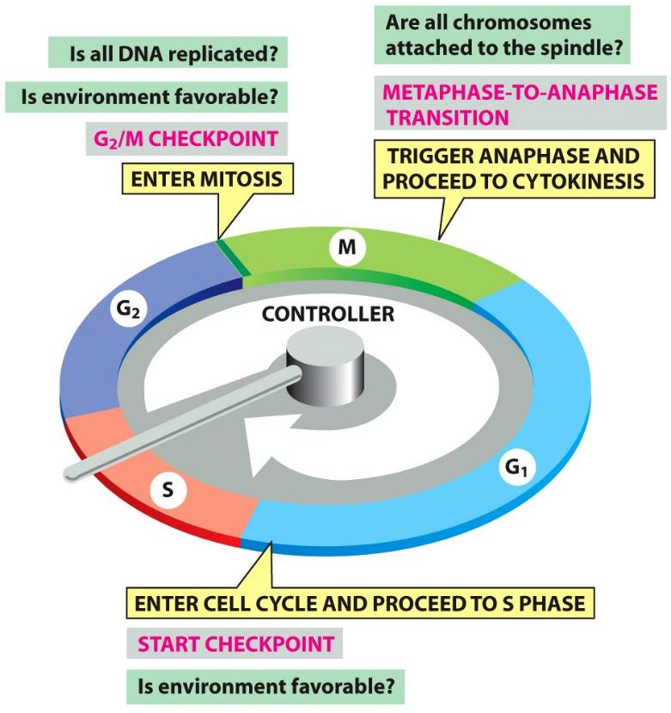
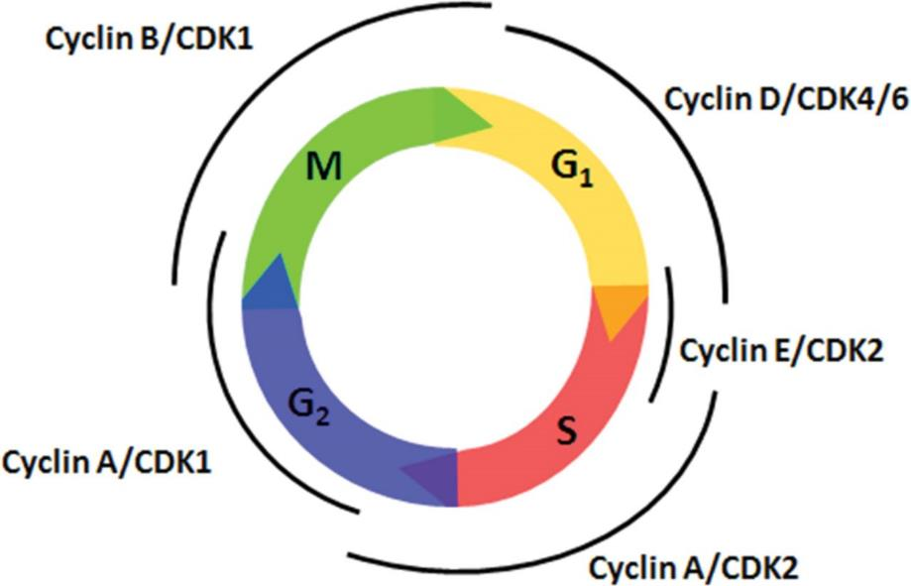
“引擎”与“刹车” engine and brake
细胞周期蛋白依赖的蛋白激酶复合物（cyclin-dependent kinase complex，CDK）
“brake”
Figure 17-14 Molecular Biology of the Cell (© Garland Science 2008)

Slide 6
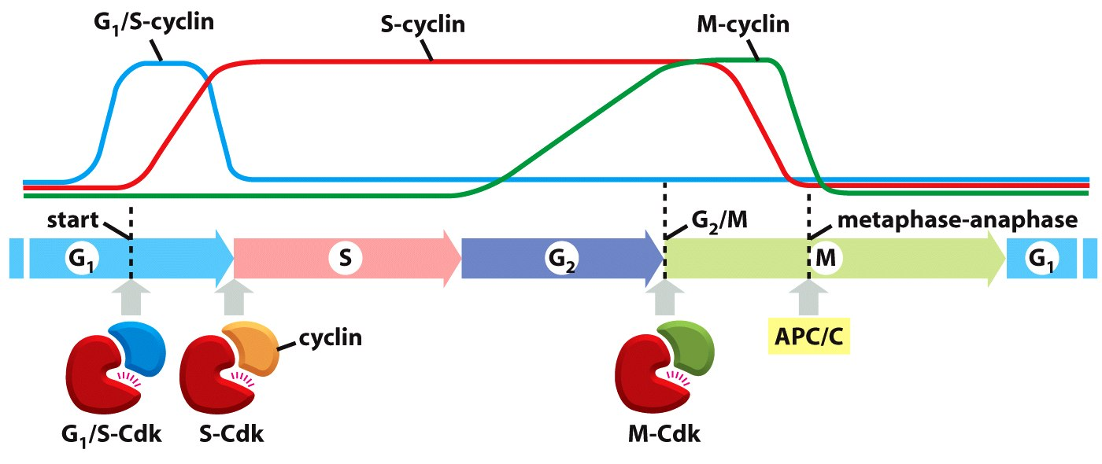
细胞增殖调控机制的核心——一组蛋白激酶
Figure 17-16 Molecular Biology of the Cell (© Garland Science 2008)
“Each of the different cyclin-Cdk complexes serves as a molecular switch that triggers a specific cell-cycle event.”
源于对酵母、非洲爪蟾、和人类细胞的多层次研究汇总

Slide 7
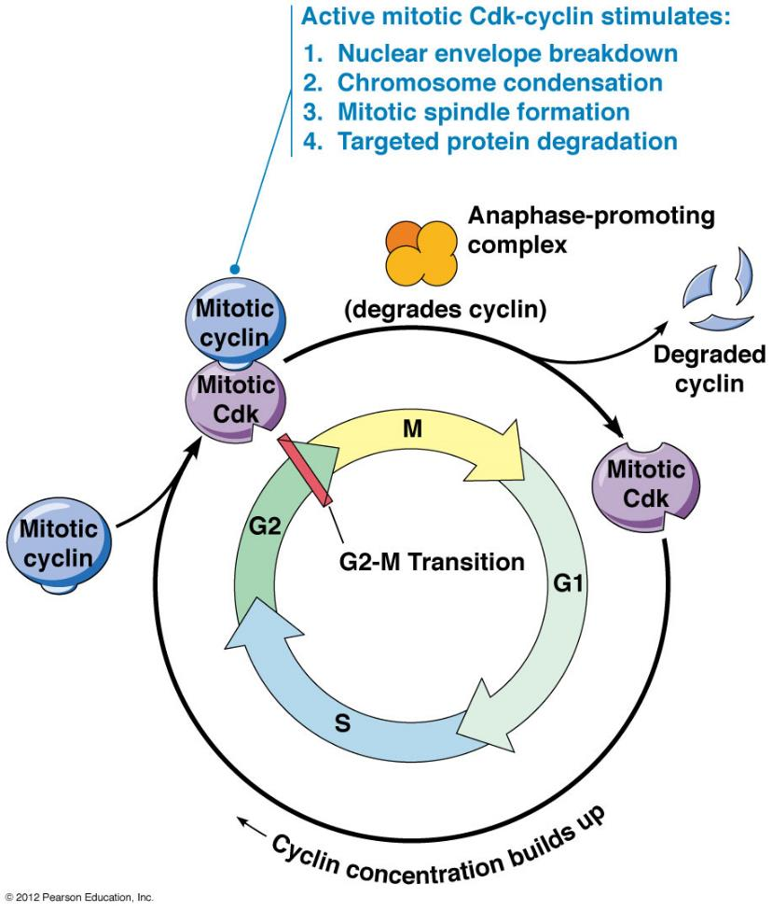
一、MPF的发现及其作用
卵细胞成熟促进因子（maturation promoting factor）
细胞有丝分裂促进因子（mitosis promoting factor）
M 期促进因子（M-phase promoting factor）
Notes:
http://www.mun.ca/biology/desmid/brian/BIOL2060/BIOL2060-19/19_37.jpg

Slide 8
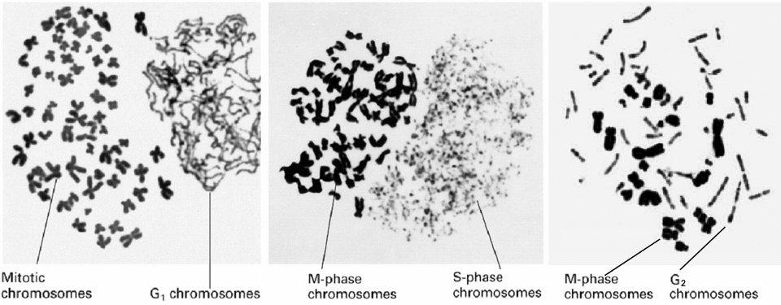
1. 细胞融合实验——有丝分裂促进因子
1970s Rao和Johnson（Colorado 大学）发现与M期细胞(HeLa)融合的间期细胞染色体发生凝缩，并称之为早熟染色体凝缩（premature chromosome condensation，PCC）。此种染色体则称为早熟凝缩染色体
G1期PCC为细单线状，因DNA未复制
S期PCC为粉末状，因DNA由多个部位开始复制
G2期PCC为双线染色体状，说明DNA复制已完成
M期细胞存在诱导染色体凝缩的因子，称为细胞有丝分裂促进因子
Notes:
最早发现有丝分裂促进因子（MPF）的存在是通过哪一个实验证实的？现已证明MPF的二种生化成分是什么？
答案：应用细胞融合技术所进行的早熟染色体凝集实验。MPF由二个亚基组成，调节亚基为周期蛋白，催化亚基为cdc2

Slide 9
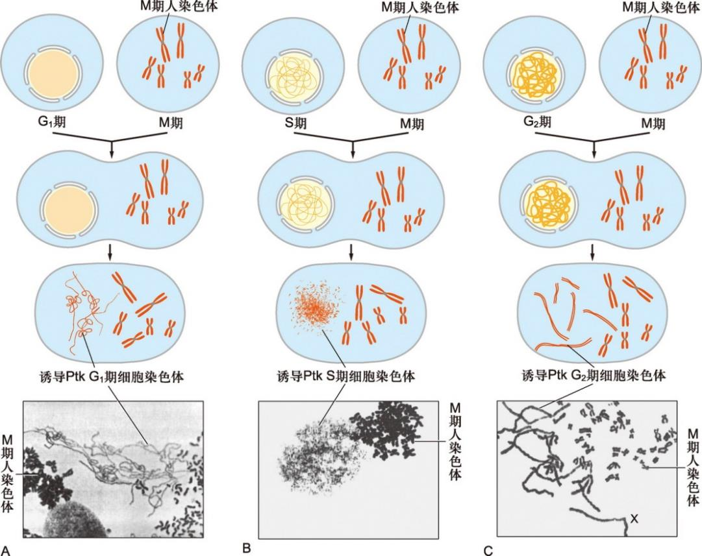
早熟染色体凝缩
图13-1 M 期细胞与G1、S 和G2 期细胞融合诱导早熟染色体凝缩
A. M 期细胞与G1 期细胞融合。B. M 期细胞与S 期细胞融合。C. M 期细胞与G2 期细胞融合

Slide 10
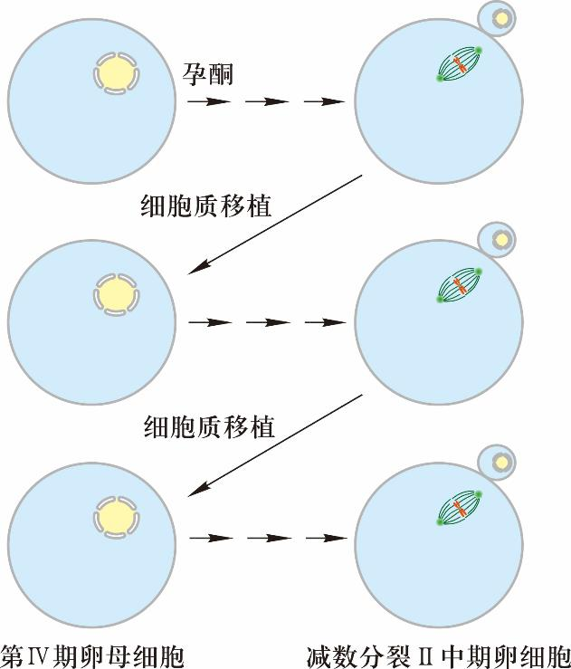
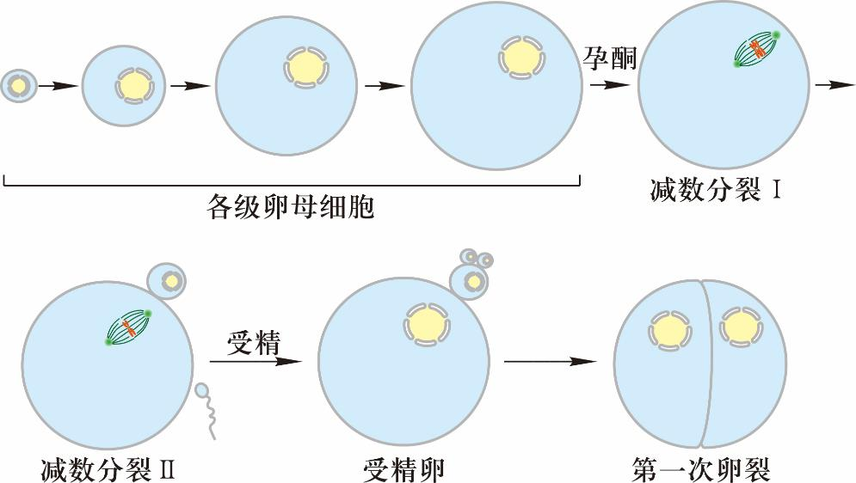
2. 成熟卵细胞细胞质移植实验——MPF概念提出
图13-2 非洲爪蟾卵细胞成熟过程、受精和第一次卵裂示意图
非洲爪蟾卵母细胞成熟过程可人为地划分为6 个时期。第I 至IV期为各级生长卵母细胞。第IV 期卵母细胞在孕酮作用下向第V 和第VI 期转化，随即开始减数分裂I 和Ⅱ。成熟卵细胞受精后，便开始第一次卵裂
图13-3 成熟卵细胞细胞质移植发现MPF 的存在

Slide 11
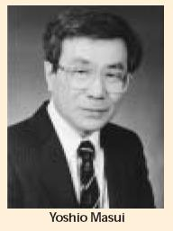
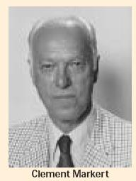
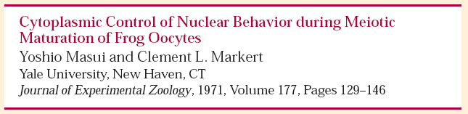
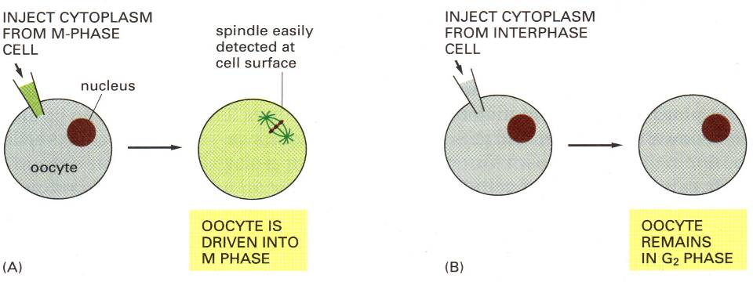
成熟卵细胞细胞质移植发现MPF 的存在
Notes:
Figure 25-9 Evidence for the Existence of MPF. Hormones act on frog oocytes to trigger meiosis and
development into mature frog eggs, which are arrested (until fertilization) in metaphase of the second meiotic
division. In 1971 Y. Masui and C. L. Markert established the existence of a substance they called maturationpromoting
factor (MPF) involved in this process. They used a micropipette to remove cytoplasm from a mature
egg cell (arrested in metaphase of the second meiotic division) and injected it into an immature oocyte. The
oocyte then proceeded through meiosis and became a mature egg cell, under the influence of MPF.

Slide 12
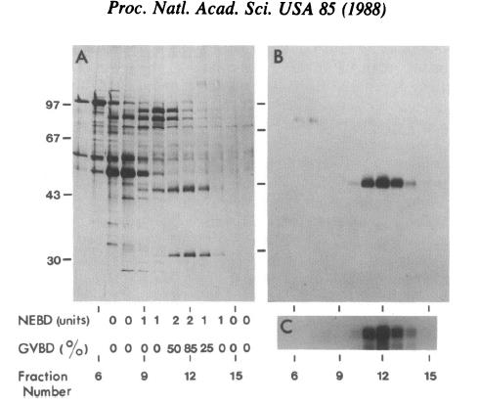
3. MPF的分离纯化（1988）——一种蛋白激酶
Ammonium sulfate precipitation and six chromatographic procedures resulted in a preparation purified greater than 3000-fold that could induce germinal vesicle breakdown within 2 hr when injected into cycloheximide-treated oocytes. Proteins of 45 kDa and 32 kDa were correlated with fractions of highest activity in both assays. These fractions contained a protein kinase activity able to phosphorylate the endogenous 45-kDa protein, as well as histone H1, phosphatase inhibitor 1, and casein.
45 kDa and 32 kDa Proteins (3000-fold activity)
Lohka, M.J.; Hayes, M.K.; Maller, J.L. PNAS. USA 85: 3009-3013. 1988.
Notes:
Maturation-promoting factor causes germinal vesicle breakdown when injected into Xenopus oocytes and can induce metaphase in a cell-free system. The cell-free assay was used to monitor maturation-promoting factor during its purification from unfertilized Xenopus eggs. Ammonium sulfate precipitation and six chromatographic procedures resulted in a preparation purified greater than 3000-fold that could induce germinal vesicle breakdown within 2 hr when injected into cycloheximide-treated oocytes. Proteins of 45 kDa and 32 kDa were correlated with fractions of highest activity in both assays. These fractions contained a protein kinase activity able to phosphorylate the endogenous 45-kDa protein, as well as histone H1, phosphatase inhibitor 1, and casein. The highly purified preparations described here should help to identify the mechanism of action of maturation-promoting factor and to elucidate the role of protein kinases in the induction of metaphase.

Slide 13
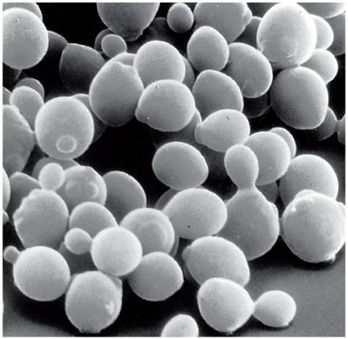
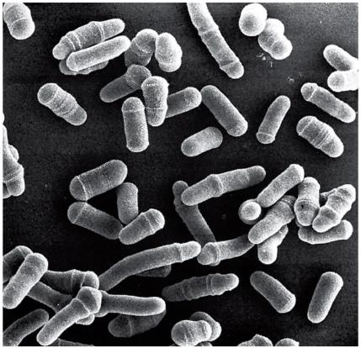
二、p34^{cdc2} 激酶的发现及其与MPF 的关系
1960s Leland Hartwell，1970s Paul Nurse 分别以芽殖酵母和裂殖酵母为实验材料，利用温度敏感突变株（temperature-sensitive mutants，ts），发现许多与细胞分裂周期基因（cell division cycle gene, cdc）
cdc 基因根据被发现先后顺序命名
允许温度（permissive temperature）
限定温度（restrictive temperature）

Slide 14
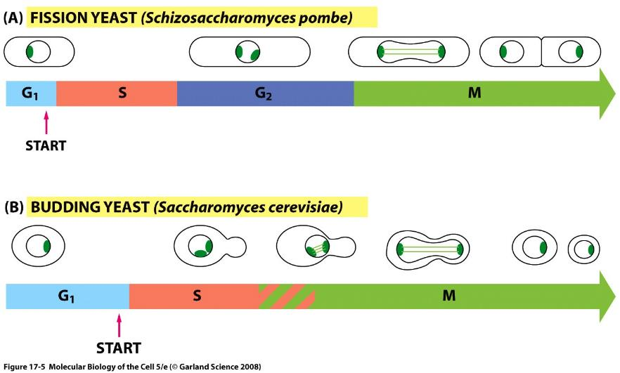
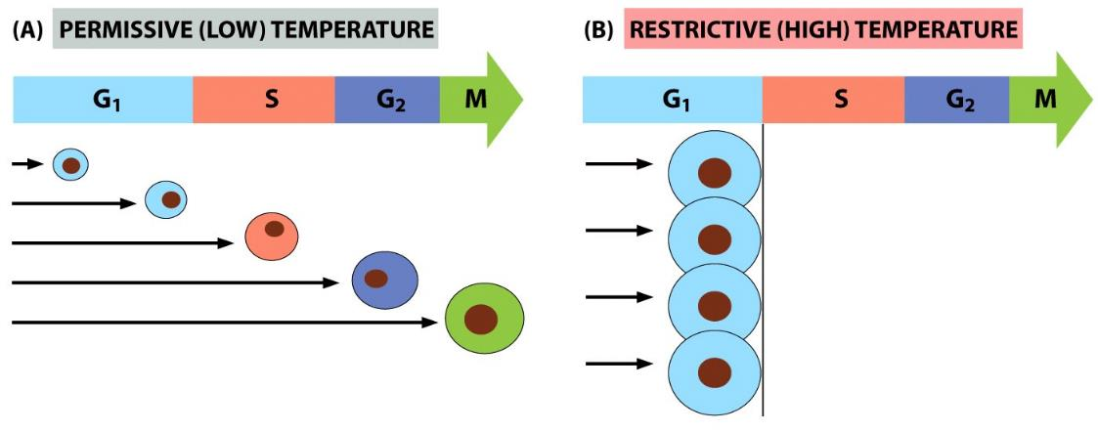
芽殖酵母和裂殖酵母 允许温度和限定温度
Notes:
Most conditional cell-cycle mutants are temperature-sensitive mutants in which the mutant protein fails to function at high temperatures but functions well enough to allow cell division at low temperatures. A temperature-sensitive cdc mutant strain of cells can be grown at low temperature (the permissive condition) and then raised to a higher temperature (the restrictive condition) to switch off the function of the affected gene. All of the cells will continue their cycling until they reach the point where the function of the mutant gene is required for further progress, and at this point they will all stop

Slide 15
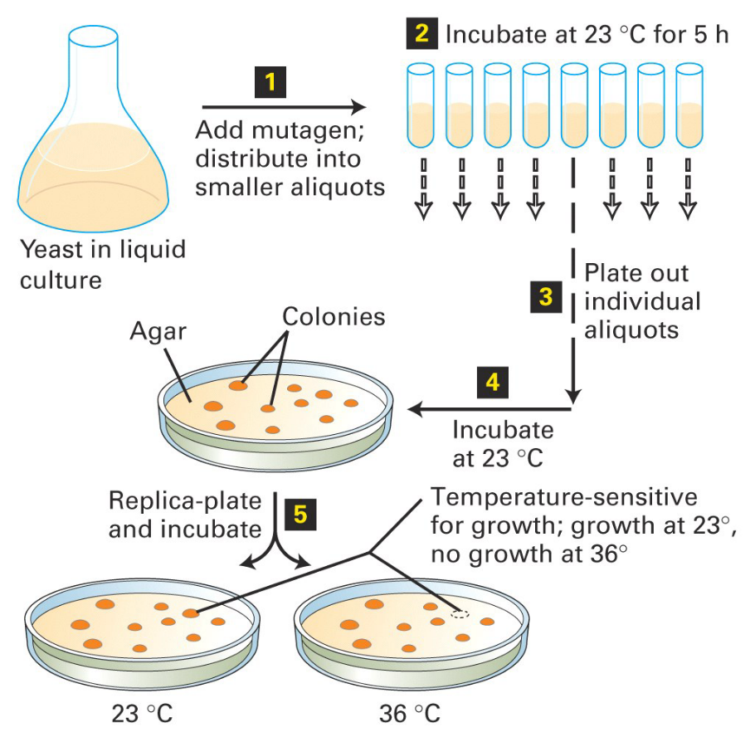
酵母温度敏感突变株的筛选

Slide 16
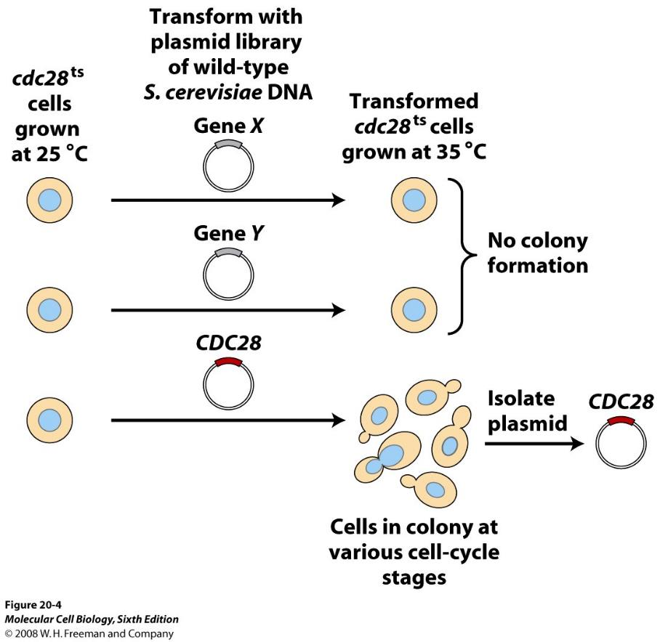
芽殖酵母 cdc28 基因的发现

Slide 17
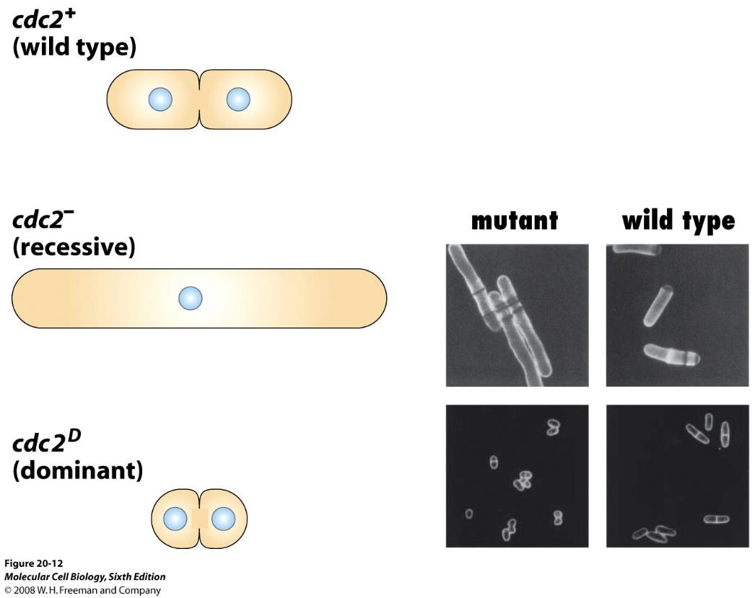
裂殖酵母 cdc2 基因
Notes:
In the cdc2- mutant, which has a recessive 隐性 phenotype, the cdc2 gene is inactivated. At the restrictive condition, the cell fails to pass the mitotic entry checkpoint, continues growing, and so becomes enormously large. Conversely, the dominant 显性 cdc2 mutant, cdc2D, in which the cdc2 gene product is hyperactive, passes the checkpoint prematurely, at an abnormally small size.

Slide 18
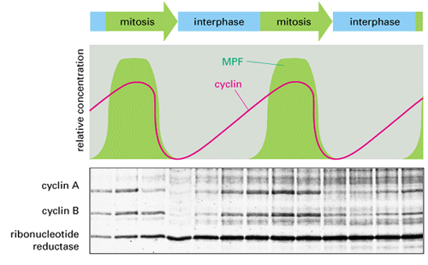
海胆卵细胞实验——周期蛋白Cyclin的发现
Evans, T.; Rosenthal, E.T.; Youngblom, J.; Distel, D.; Hunt, T. Cell 33: 389-396. 1983.
The discovery of cyclin and the activity levels of MPF during the early embryonic cell cycle
Notes:
The synthesis of proteins in fertilized sea urchin eggs (whose cell cycle is similar to that of Xenopus embryos) was examined by fertilizing a batch of eggs in sea water containing a radioactive amino acid (³⁵S-methionine), removing samples periodically, and running them on a gel. Once they had been separated on the gel, the freshly made proteins could be visualized by virtue of their radioactivity. Evans, T.; Rosenthal, E.T.; Youngblom, J.; Distel, D.; Hunt, T. Cell 33: 389-396. 1983.

Slide 19
小结：MPF的发现
HeLa细胞融合实验：有丝分裂促进因子
非洲爪蟾卵细胞提取物注射实验：MPF概念提出
酵母温度敏感突变株：cdc基因，p34^{cdc2}，Cdc28
海胆卵细胞实验：Cyclin的发现
MPF生化成分：Cdc2 （催化亚基）和 Cyclin（调节亚基）
The story of the work in identifying the key regulators of the cell division cycle and the 2001 Nobel Prize for Physiology or Medicine

Slide 20
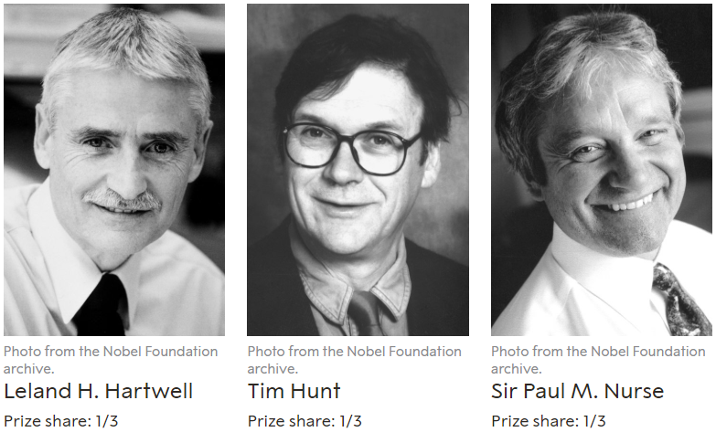
The Nobel Prize in Physiology or Medicine 2001
cdc28
cyclin
cdc2
"for their discoveries of key regulators of the cell cycle".

Slide 21
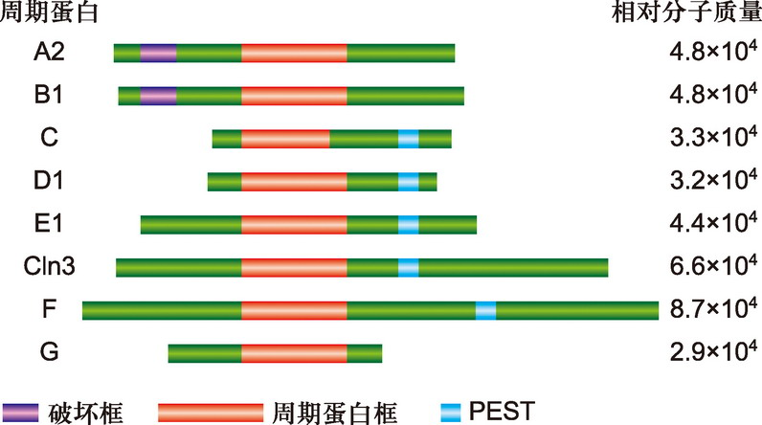
三、周期蛋白 cyclin
周期蛋白框：介导周期蛋白与CDK 结合
破坏框：参与泛素依赖性的cyclin A 和B 的降解
PEST序列：与G1周期蛋白更新有关
图13-4 部分周期蛋白分子结构特征
图中显示的，除Cln3 外，均为人类的周期蛋白分子。所有这些分子均含有一个周期蛋白框。M 期周期蛋白（A2、B1）分子的N 端含有一个破坏框。G1 期周期蛋白的C 端含有一个PEST 序列

Slide 22
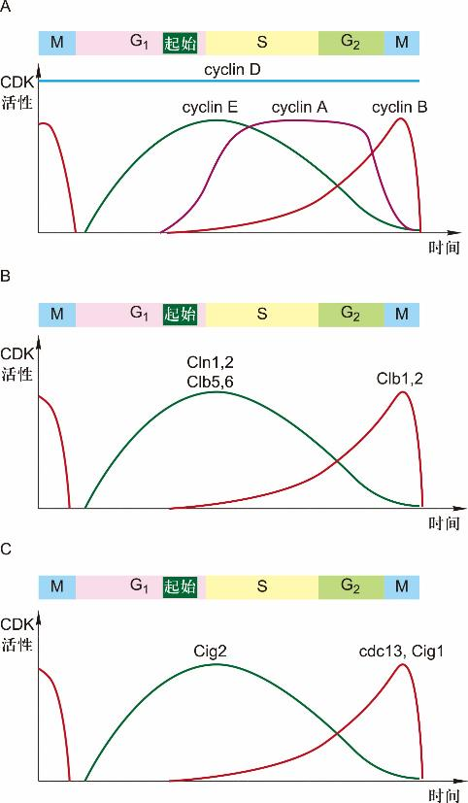
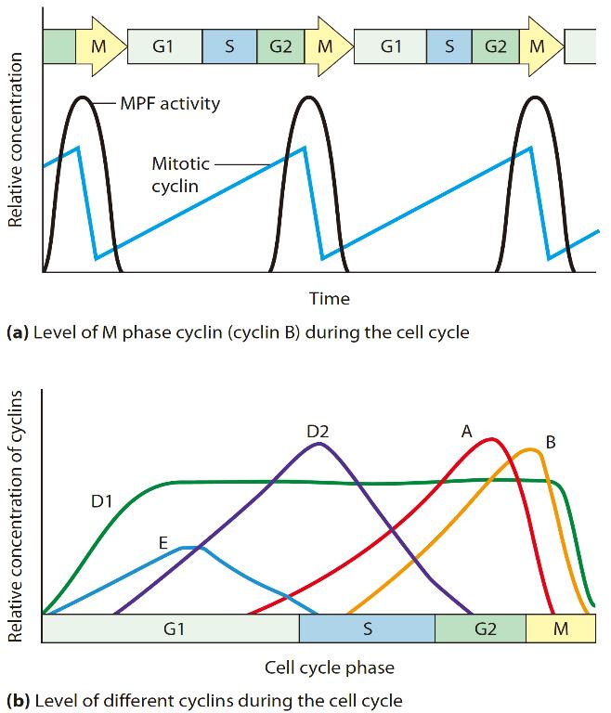
不同周期蛋白在细胞周期中积累及其与CDK 活性的关系
不同的周期蛋白在细胞周期中表达的时期不同，并与不同的CDK 结合，调节不同的CDK 活性
图13-5 部分哺乳动物和酵母细胞周期蛋白在细胞周期中的积累及其与CDK 活性的关系
A. 哺乳动物细胞周期。B. 芽殖酵母细胞周期。C. 裂殖酵母细胞周期
Notes:
在哺乳动物细胞中，cyclin A 在G1 期的 早期即开始表达并逐渐积累，到达G1/S 期交界处，其 含量达到最大值并一直维持到G2/M 期。cyclin B 则从 G1 期晚期开始表达并逐渐积累，到G2 期后期阶段达到 最大值并一直维持到M 期的中期阶段，然后迅速降解。 作为G1 期周期蛋白的cyclin D 在细胞周期中持续表达， 而cyclin E 则在M 期的晚期和G1 期早期开始表达并逐 渐积累，到达G1 期的晚期，其含量达到最大值，然后 逐渐下降，到达G2 期的晚期，其含量降到最低值。
Figure 24-15 Fluctuating Levels of Cyclins and MPF Activity During the Cell Cycle. (a) Cellular levels of mitotic cyclin (cyclin B) rise during interphase (G1, S, and G2), then fall abruptly during M phase. The peaks of MPF activity (assayed by testing for the abilityto stimulate mitosis) and cyclin concentration correspond, although the rise in MPF activity is not significant until a threshold concentration of cyclin is reached. Active MPF has been found to consist of a combination of mitotic cyclin and mitotic Cdk. The mitotic Cdk itself is present at a constant concentration (not shown on the graph) because the amount of mitotic Cdk increases at a rate corresponding to the overall growth of the cell. (b) The levels of various cyclins rise and fall during specific phases of the cell cycle. Various cyclins form complexes with various Cdks to regulate key steps in the cell cycle.

Slide 23
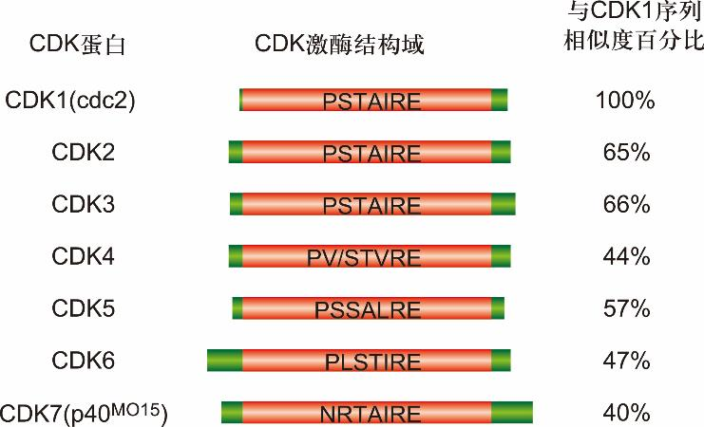
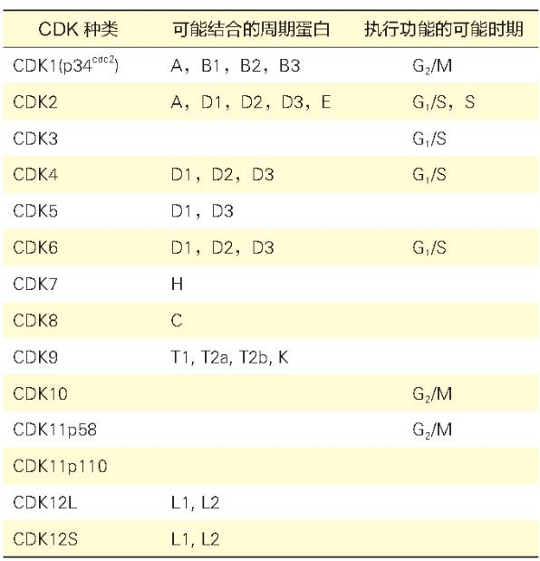
四、CDK 和CDK 抑制因子
周期蛋白依赖性蛋白激酶 （cyclin-dependent kinase，CDK）
含有一段类似的氨基酸序列，CDK 激酶结构域 (CDK kinase domain)
都可与周期蛋白结合，并以周期蛋白作为调节亚单位，表现出蛋白激酶活性
PSTAIRE 序列：与周期蛋白结合有关
磷酸化修饰位点
表13-1 某些CDK 与周期蛋白的配对关系及执行功能的时期
图13-6 通过PCR 技术测定与CDK1 类似的CDK 蛋白分子图解
图中以CDK1（cdc2） 氨基酸序列为标准（100%）， 将其他CDK 激酶结构域的氨基酸序列与其比较，得到序列相似度百分比

Slide 24
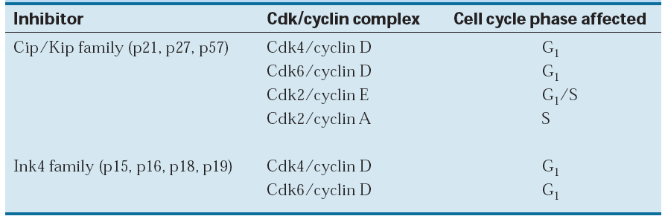
CDK 抑制因子（cyclin-dependent kinase inhibitor，CKI）
CKI对细胞周期起负调控作用
Ink4 (Inhibitor of cdk4): P16^{ink4a}, P15^{ink4b}, P18^{ink4c}, P19^{ink4d}。特异性抑制CDK4·cyclin D1, CDK6·cyclin D1
Kip (Kinase inhibition protein)：P21^{cip1} (cyclin inhibition protein 1）P27^{kip1}、P57^{kip2}，抑制大多数CDK的激酶活性。P21^{cip1}还能与DNA聚合酶δ的辅助因子PCNA（proliferating cell nuclear antigen）结合，直接抑制DNA的合成
Notes:
P21Cip1/WAF1可与CDK2结合并抑制CDK2激酶的蛋白质 (CDK inhibited protein，Cip1)。P21还是野生型P53的下游作用因子 (wild-type P53 active factor，WAF1)

Slide 25
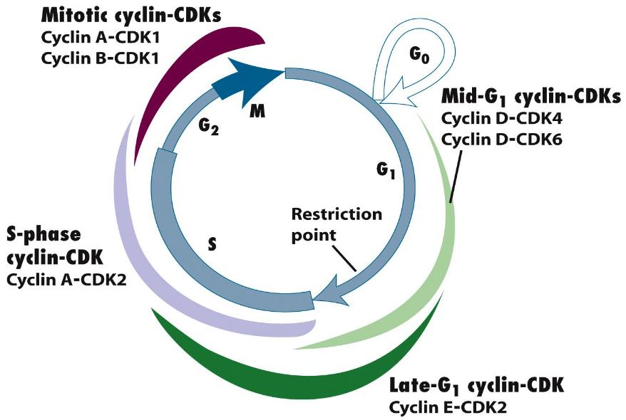
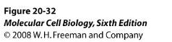
五、细胞周期运转调控
周期引擎分子(engine molecule)：不同种类Cyclin与不同种类CDK 结合，在细胞周期不同时期表现活性，推动细胞周期运转
Notes:
G1期，在生长因子的刺激下，cyclin D表达，并与CDK4、CDK6结合，使下游的蛋白质如Rb磷酸化，Rb释放出转录因子E2F，促进许多基因的转录，如编码cyclinE、A和CDK1的基因。
G1-S期，cyclinE与CDK2结合，促进细胞进入S期。CyclinE的抗体能使细胞停滞于G1期。
G2-M期，cyclinA、cyclinB与CDK1结合，CDK1使底物蛋白磷酸化、如将组蛋白H1磷酸化导致染色体凝缩，核纤层蛋白磷酸化使核膜解体。

Slide 26

三个主要问题
不同时相Cyclin-Cdk复合物活性调控及其用机制？
如何保证每个细胞周期DNA只在S期复制一次？
检验点如何发挥作用？
Cell cycle transitions are regulated by cyclin-CDK protein kinases, protein phosphatases, and ubiquitin-protein ligases

Slide 27

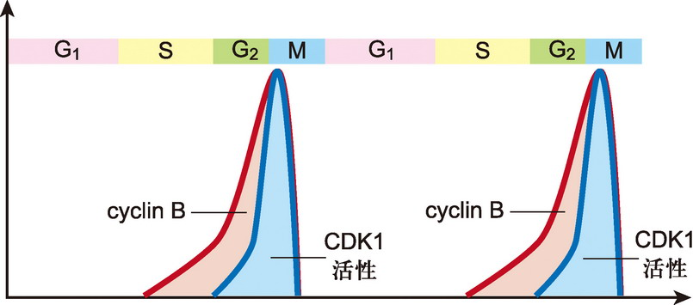
（一）G₂/M 期转化与CDK1 的关键性调控作用
CDK1 = MPF = p34^{cdc2}/p34^{cdc28} + cyclin B
CDK1 活性和cyclin B 含量的关系
图13-7 cyclin B 在CDK1 活性调节过程中的作用
CDK1 活性首先依赖于cyclin B 含量的积累。cyclin B 的含量达到一定值并与CDK 蛋白结合，同时在其他一些因素的调节下，逐渐表现出最高激酶活性

Slide 28
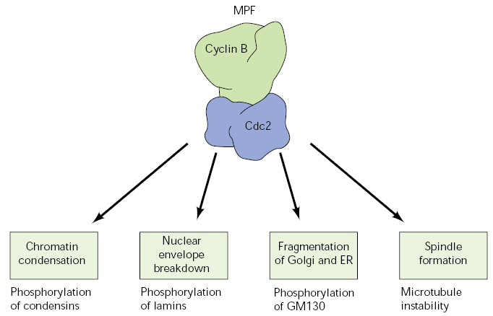
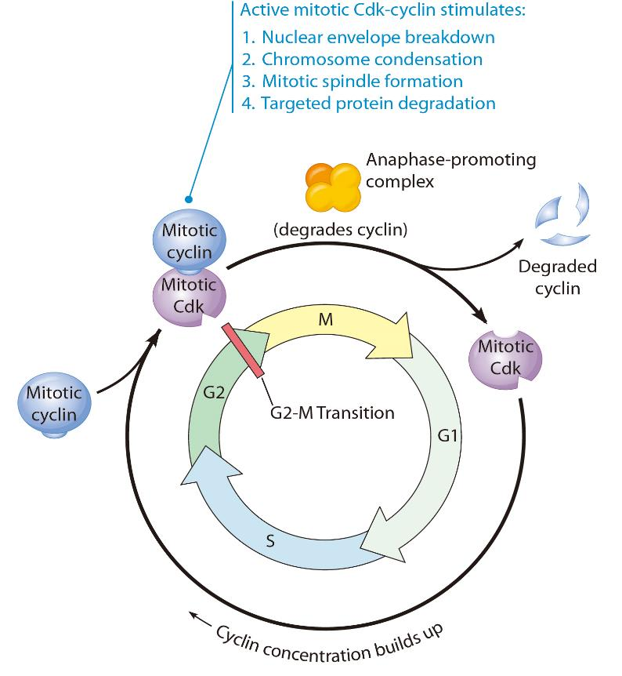
MPF（CDK1）启动细胞从G₂期进入M期的相关事件
MPF活性如何调节？其它时相进程如何推动？
Notes:
Figure 24-17 The Mitotic Cdk Cycle. This diagram illustrates the activation and inactivation of the mitotic Cdk protein during the cell cycle. In G1, S, and G2, mitotic Cdk is made at a steady rate as the cell grows, while the mitotic cyclin concentration gradually increases. Mitotic Cdk and cyclin form an active complex whose protein kinase activity drives the cell cycle through the G2-M transition and into mitosis by stimulating the mitotic events listed. By activating a protein-degradation pathway that degrades cyclin, the mitotic Cdk-cyclin complex also brings about its own demise, allowing the completion of mitosis and entry into G1 of the next cell cycle.

Slide 29
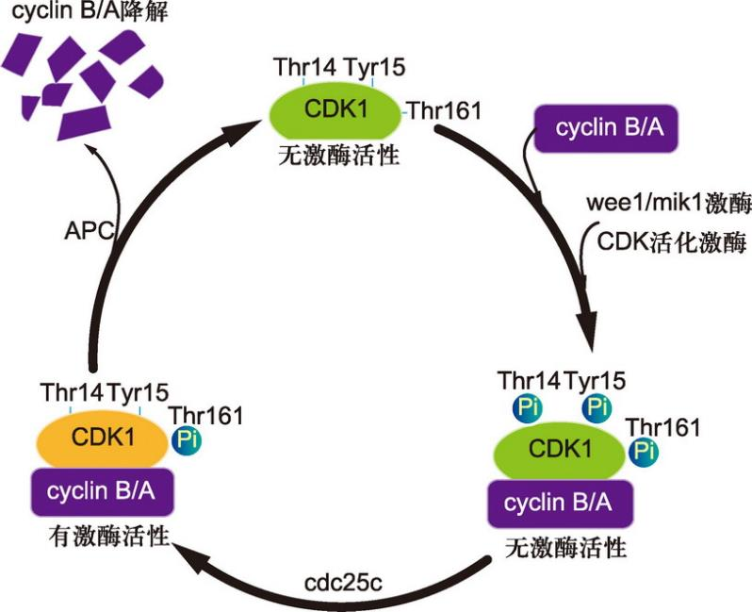
CDK 活性受多种因素综合调节
Cyclin 的合成与降解：周期蛋白与CDK 结合是激活CDK 活性的先决条件
CDK活化激酶（CDK-activating kinase, CAK）的激活
Thr 160/161的磷酸化
wee1/mik1和Cdc25C的磷酸化与去磷酸化作用
Thr14 / Tyr15的磷酸化与去磷酸化
CKIs的结合与否
图13-8 CDK1 激酶活性综合调控示意图
Notes:
CDC2(CDK1): Thr 161；Thr 14/ Tyr 15
CDK2: Thr 160； Thr 14/ Tyr 15

Slide 30
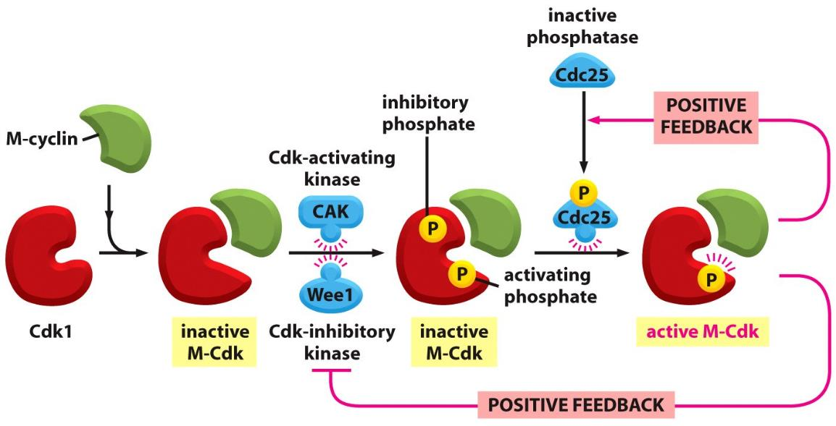
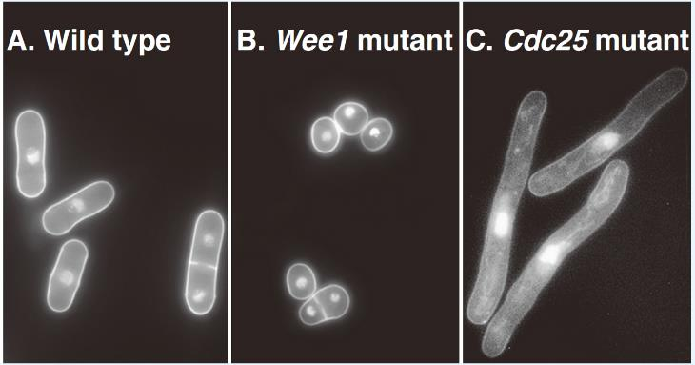
CDK 激酶活性综合调控
Figure 17-25 Molecular Biology of the Cell (© Garland Science 2008)
Notes:
FIGURE 40.6 FLUORESCENCE MICROGRAPHS OF FISSION YEAST CELLS ILLUSTRATING PHENOTYPES OF CELL-CYCLE MUTATIONS. Cell walls and nuclei are stained. A, Wild-type cells. B, A wee1 mutation that accelerates entry into mitosis at the restrictive temperature. C, A cdc25 mutation that delays entry into mitosis at the restrictive temperature.

Slide 31
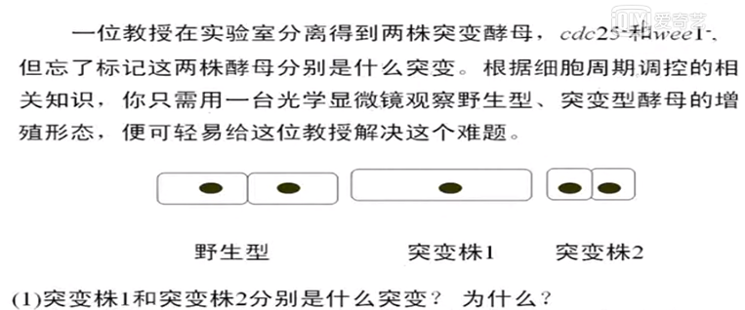

Slide 32
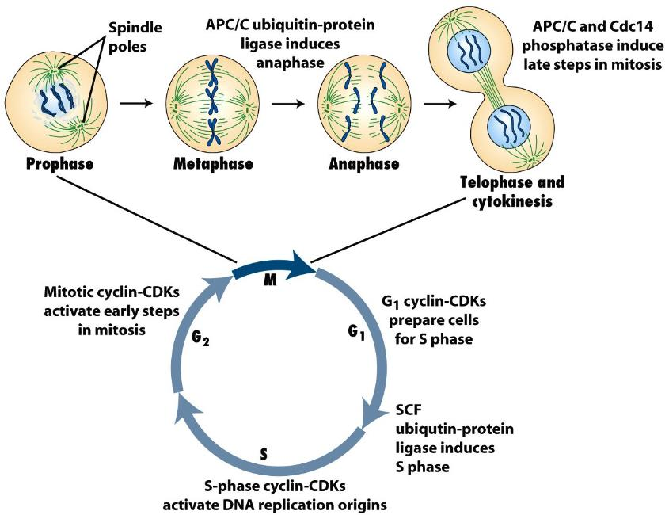
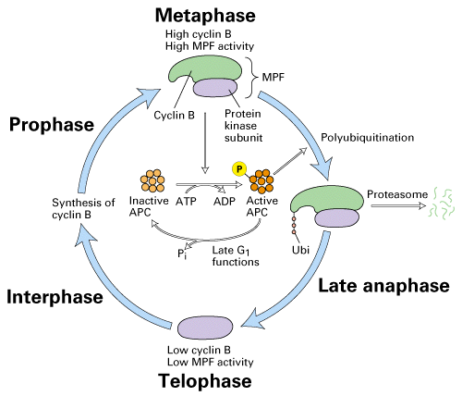
（二）M 期周期蛋白与细胞分裂中期向后期转换
M 期cyclin A 和B将迅速降解，CDK1 活性丧失；被CDK1 磷酸化的靶蛋白去磷酸化，细胞周期便从M 期中期向后期转化。cyclin A 和B 的降解是通过泛素化依赖途径实现

Slide 33
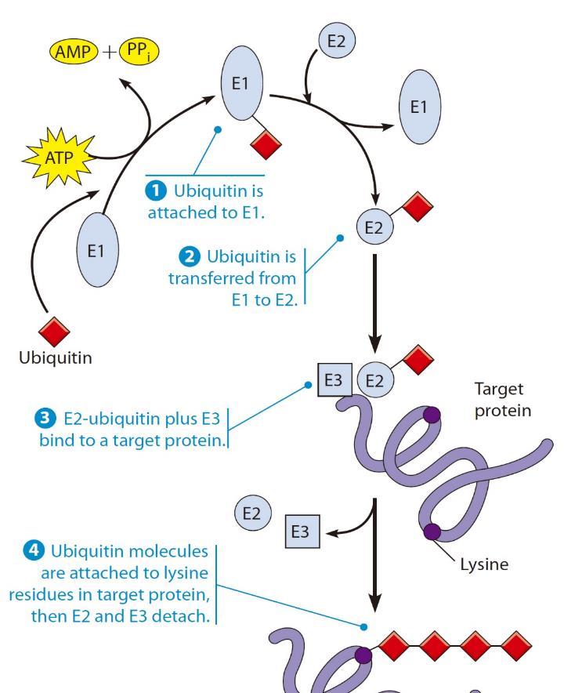
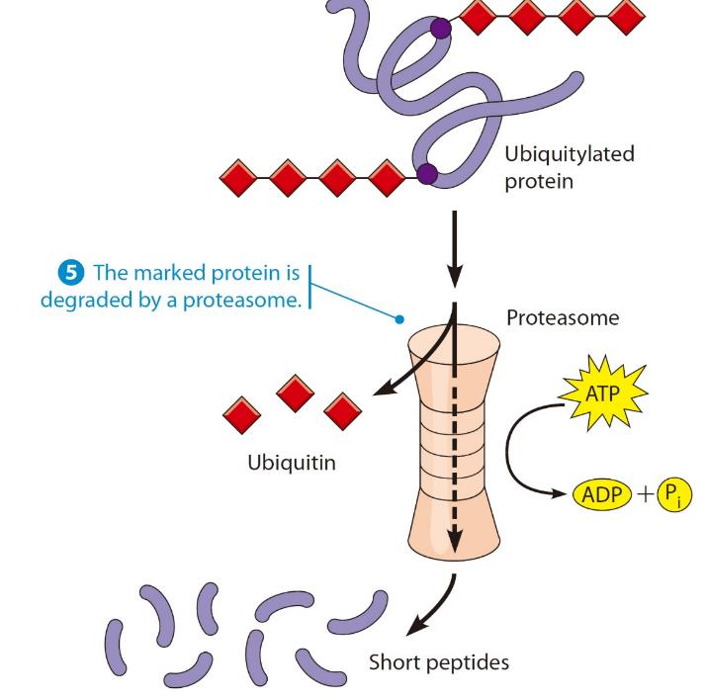
Ubiquitin-Proteasome System
Notes:
Figure 20-38 Ubiquitin-Proteasome System for Regulated Protein Degradation. Ubiquitin is attached to lysine in targeted proteins through the sequential action of a ubiquitin-activating enzyme (E1), a ubiquitin-conjugating enzyme (E2), and a ubiquitin ligase (E3). A proteasome then degrades the targeted protein into short peptides.

Slide 34
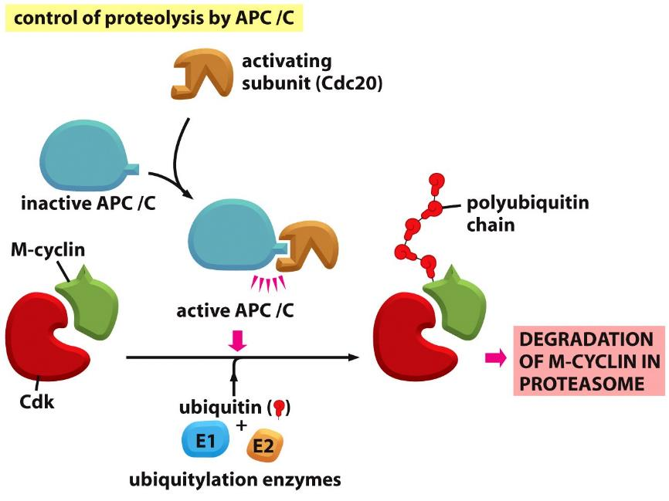
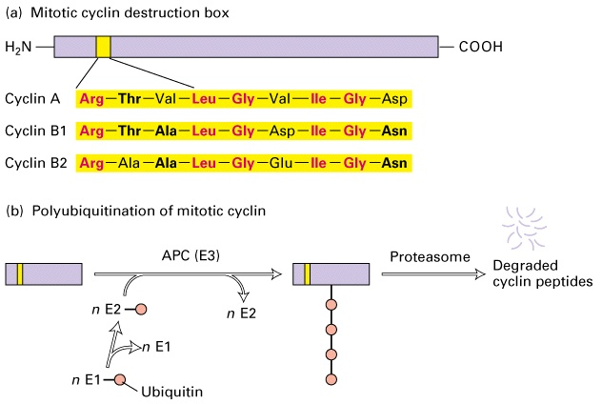
Anaphase promoting complex，APC
Anaphase-Promoting Complex, also called cyclosome (APC/C), is an E3 ubiquitin ligase.在APC作用下，M 期cyclin A 和B 通过泛素化依赖途径降解
Figure 17-20a Molecular Biology of the Cell (© Garland Science 2008)

Slide 35
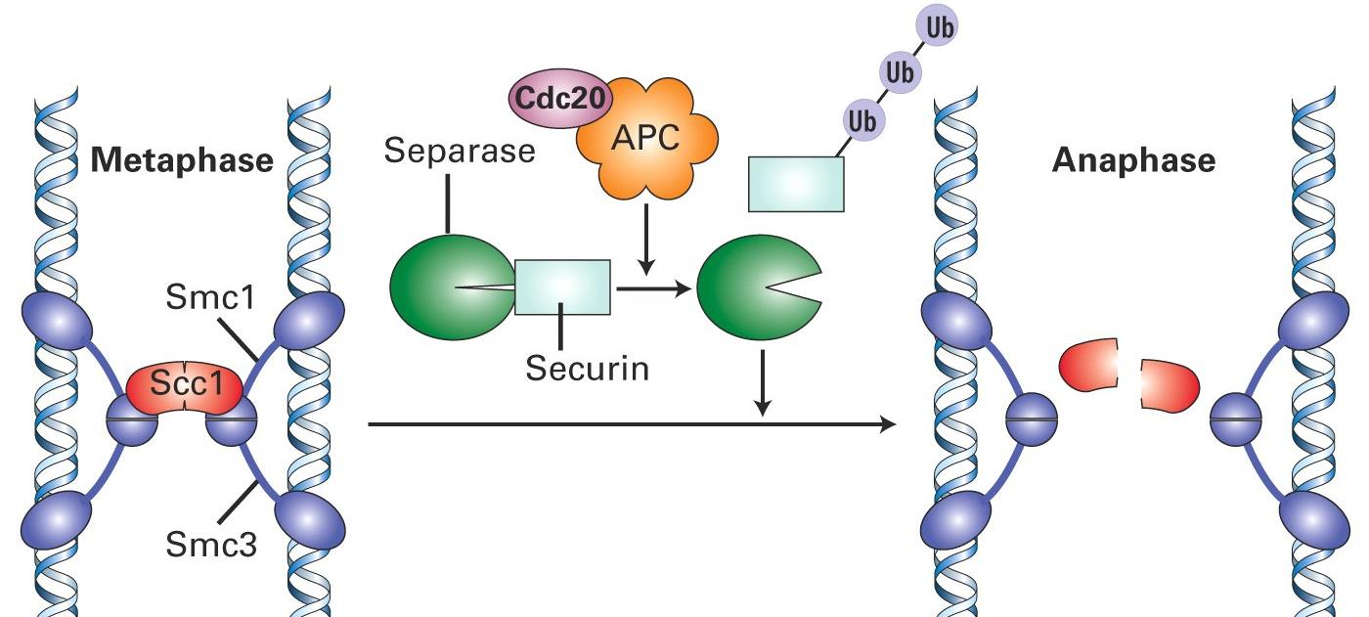
姐妹染色单体分离机制
中期，黏连蛋白cohesin将姐妹染色单体黏合在一起；后期，分离酶抑制剂Securin被分解，分离酶被激活，切割黏连蛋白，姐妹染色单体分离

Slide 36
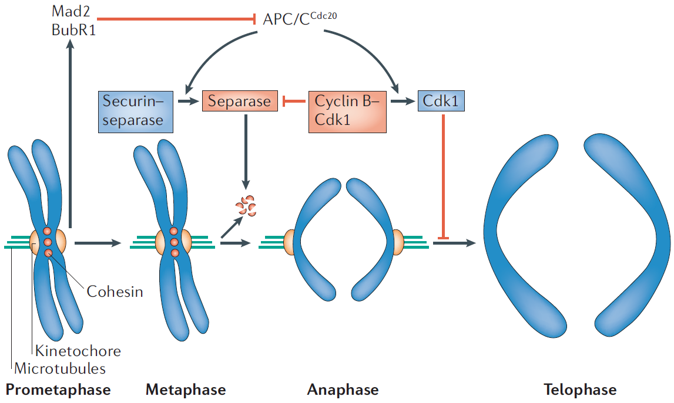
Spindle Assembly Checkpoint: Mad and Bub Proteins
Nature Reviews Molecular Cell Biology 7, 644-656 (September 2006)
Mad2（有丝分裂阻滞缺陷蛋白2，mitotic arrest deficient protein 2）
Bub（budding uninhibited by benzimidazole）
Notes:
Figure 2 | Regulation of anaphase and mitotic exit by APC/C^{Cdc20}.
During prometaphase, spindle-assembly-checkpoint proteins such as Mad2 and BubR1 are activated at kinetochores that are not (or not fully) attached with microtubules (indicated in green). Activated Mad2 and BubR1 inhibit the capability of anaphase promoting complex/cyclosome ^{Cdc20} (APC/C^{Cdc20}) to ubiquitylate securin and cyclin B and thereby prevent anaphase and mitotic exit. In metaphase, when all kinetochores are attached to microtubules, APC/C^{Cdc20} ubiquitylates securin and cyclin B and thereby activates the protease separase and inactivates the cyclin-dependent kinase-1 (Cdk1). Separase then cleaves cohesin complexes (shown as red circles) that are holding sister chromatids together and thereby initiates sister-chromatid separation. Cdk1 inactivation leads to the dephosphorylation of Cdk1 substrates by protein phosphatases, and thereby enables exit from mitosis. In vertebrates, CDK1 inactivation also contributes to separase activation.
APC主要介导两类蛋白降解: Anaphase Inhibitors和Mitotic Cyclin. 前者维持姐妹染色单体粘连, 抑制后期启动；后者的降解意味着有丝分裂即将结束，即染色体开始去凝集，核膜重建。
APC介导选择性降解的靶蛋白与Ubiquitin结合 (通过泛素依赖性途径降解) Cdc20 和Mad2蛋白位于动粒上，在染色体结合有丝分裂纺锤体前将不能从动粒上释放，由于Mad2与Cdc20结合而抑制APC的活性。所以只有所有染色体都与纺锤体结合后，APC才有活性，才启动细胞向后期转换。
Mad2（有丝分裂阻滞缺陷蛋白2，mitotic arrest deficient protein 2）
Bub(budding uninhibited by benzimidazole)

Slide 37
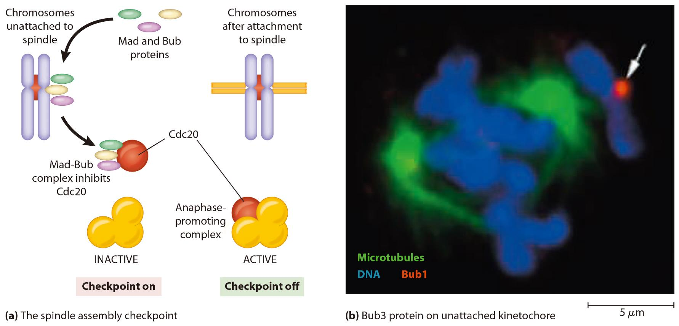
Spindle Assembly Checkpoint: Mad and Bub Proteins
Notes:
Figure 24-21 The Spindle Assembly Checkpoint. (a) A model for the spindle assembly checkpoint
shows how chromosomes that are not attached to the spindle may organize Mad and Bub proteins into a complex
that inhibits the anaphase-promoting complex, thereby delaying the onset of anaphase until all chromosomes
are attached to the spindle. (b) When a cultured Drosophila cell is treated with a low dose of paclitaxel,
a chromosome is slow to arrive at the metaphase plate (arrow); Bub1 is found at its kinetochore (red).

Slide 38
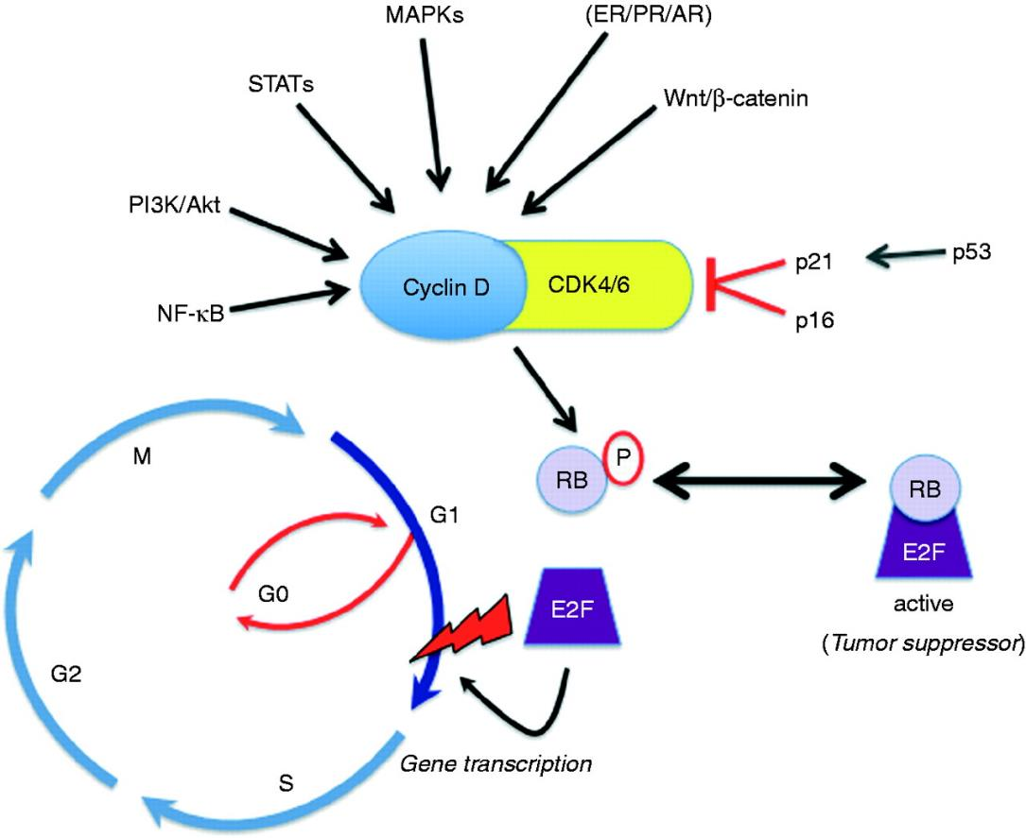

（三）G1/S 期转化与G1 期周期蛋白依赖性CDK
Endocr Relat Cancer August 1, 2011 vol. 18 no. 4 C19-C24
Notes:
细胞由G1 期向S 期转化主要受G1 期周期蛋白依赖性CDK 所控制。在哺乳动物细胞中，G1 期周期蛋白主要包括cyclin D、E，或许还有cyclin A。与G1 期周期蛋白结合的CDK 主要包括CDK2、CDK4 和CDK6 等
http://erc.endocrinology-journals.org/content/18/4/C19/F1.expansion.html
Figure 1Regulation of cell cycle checkpoint control. Mitogenic signals converge at the level of cyclin D1 upregulation and CDK4/6 association, localization, and kinase activity. CDK4/6 phosphorylates and inactivates RB tumor suppressor proteins, leading to dissociation of E2F transcription factors and transcriptional regulation of genes important for G1/S transition and cell cycle progression through the restriction point (lightning bolt).

Slide 39


G1-S: G1 Cdk-Cyclin and the Rb Protein
Rb bind with E2F transcription factor
Notes:
Figure 24-19 Role of the Rb Protein in Cell Cycle Control. In its dephosphorylated state, the Rb protein binds to the E2F transcription factor. This binding prevents E2F from activating the transcription of genes coding for proteins required for DNA replication, which are needed before the cell can pass through the restriction point into S phase. In cells stimulated by growth factors, the Ras pathway is activated (see Figure 24-25), which leads to the production and activation of a G1 Cdk-cyclin complex that phosphorylates the Rb protein. Phosphorylated Rb can no longer bind to E2F, thereby allowing E2F to activate gene transcription and trigger the onset of S phase. During the subsequent M phase (not shown), the Rb protein is dephosphorylated so that it can once again inhibit E2F.

Slide 40

视网膜母细胞瘤（retinoblastoma） 与Rb 基因——抑癌基因

Slide 41

SCF 泛素化依赖蛋白质降解途径（G1 cyclin）
SCF 是一种多亚基构 成的蛋白复合物，具有E3 泛素连接酶的功能
由Skp1、Cul1 和Rbx1 三种亚基构成
Degradation of an S Phase CDK Inhibitor triggers DNA Replication
图13-10 SCF 泛素化依赖蛋白质降解途径
Notes:
G1、S期：SCF泛素化途径(the ubiquitin pathway)是一种有高度选择性的蛋白水解途径，是细胞周期调控的基础。依赖SCF(skp-cullin-F-box protein)和APC/C(anaphas-promoting complex or cyclosome)的两种泛素化途径对细胞周期不同时期的调控作用。

Slide 42

三个主要问题
不同时相Cyclin-Cdk复合物活性调控及其用机制？
如何保证每个细胞周期DNA只在S期复制一次？
检验点如何发挥作用？

Slide 43


DNA 复制执照因子学说（DNA replication-licensing factor theory）
复制起始点识别复合物（origin recognition complex，ORC）
Mcm 蛋白（minichromosome mantenance protein）
图13-11 ORC、cdc6、cdc45、CDK 和Mcm 与染色质的结合及其在DNA 复制起始调控中的作用
Notes:
在整个细胞周期中DNA 复制一次，而且只能一次。
执照因子假说——对细胞核染色质DNA
复制发行“执照”（licensing）。
在M 期，细胞核膜破 裂，胞质中的执照因子与染色质接触并与之结合，使后者获得DNA 复制所必需的“执照”。细胞通过G1 期
后进入S 期，DNA 开始复制。
随DNA 复制过程的进行，“执照”信号不断减弱直到消失。
到达G2 期，细胞核不再含有“执照”信号，DNA 复制结束并不再起始。只有等到下一个M 期，染色质再次与胞质中的执照因子接触，重新获得“执照”，细胞核才能开始新一轮的DNA 复制。
DNA 复制执照因子的主要成分Mcm 蛋白（minichromosome mantenance
protein）是其主要成分。

Slide 44

每个细胞周期中DNA只在S期复制一次
Origin-recognition complex (ORC)
Minichromosome maintenance protein complex (MCM)
replication initiation factors: Cdc6 and Cdt1
Concomitant with activation of the MCM helicases, Cdc6 and Cdt1 dissociate from the sites of DNA replication initiation. Once they have done so, their phosphorylation leads to their degradation by the SCF ubiquitin-protein ligase. Phosphorylation of the MCM helicases leads to the export of these proteins from the nucleus after they dissociate from the DNA on completion of DNA replication
Notes:
FIGURE 1916 The molecular mechanisms governing the initiation of DNA replication. Step 1 : During exit from mitosis and early G1, when CDK activity is low, the MCM loading factors ORC, Cdc6, and Cdt1 load the replicative helicase, the MCM complex, onto DNA at replication origins. Step 2 : Activation of S phase CDKs and DDK marks the onset of S phase. They phosphorylate the MCM helicase, Sld2, and Sld3 (depicted as green phosphorylation events), to facilitate the loading of MCM helicase activators—the Cdc45-Sld3 and GINS complexes—onto sites of replication initiation. Loading of these activators leads MCM helicases to unwind DNA. S phase CDKs also prevent reloading of MCM helicases by phosphorylating Cdc6 and Cdt1 (shown as yellow phosphorylation events), promoting their release from the replication origins and their degradation by SCF. S phase CDKs also phosphorylate MCM helicases, which leads to their export from the nucleus when the helicases disengage from the DNA when replication is complete. Step 3 : DNA polymerases are recruited to origins, which leads to the initiation of DNA synthesis

Slide 45


S期促进因子 (S phase-promoting factor, SPF)

Slide 46
三个主要问题
不同时相Cyclin-Cdk复合物活性调控及其用机制？
如何保证每个细胞周期DNA只在S期复制一次？
检验点如何发挥作用？

Slide 47

（四）S/G2/M 期转换与DNA 复制检查点
Notes:
DNA 复制还未完成或者DNA 复制出现问题， 细胞周期便不能向下一个阶段转换。DNA 复制检验点主要包括两种：S 期内部检验点（intra-S
phase checkpoint）以及DNA 复制检验点（replication checkpoint）
毛细血管扩张-共济失调突变基因(ataxia-telangiectasia mutated,ATM)
ATR(ATM Rad3 related)得名于其基因与ATM和裂殖酵母Rad3基因的同源性。
ATM主要对电离辐射引起的DNA断裂作出反应。ATR则对几乎所有类型DNA损伤作出反应。
Chk1主要是ATR的底物；Chk2主要是ATM的底物

Slide 48

DNA 复制检验点如何发挥作用
图13-12 S/G2/M 期转化与DNA 复制检验点
S 期内部检验点和DNA 复制检验点能够将细胞停滞在S 期和G2/M 期。当DNA 复制叉阻断引发单链DNA 时，ATR-CHK1 通路被激活。当DNA 双链断裂时，ATM-CHK2 通路被激活。S 期内部检验点由SMC1 磷酸化通路和cdc25A-CDK2/cyclin E/A-cdc45 通路介导。DNA 复制检验点主要是由ATR/CHK1 介导的cdc25A 降解从而抑制cyclin E/A-CDK2。ATM/ATR 是与PI-3-K 同源的激酶， 也是DNA损伤信号感受因子，进而激活下游信号通路。CHK2/CHK1：哺乳类细胞中DNA 损伤信号感受因子的底物，又是下游效应器分子Ser/Thr激酶

Slide 49


DNA损伤检验点
Figure 17-63 Molecular Biology of the Cell (© Garland Science 2008)

Slide 50


Role of the p53 Protein in Responding to DNA Damage
Notes:
Figure 24-22 Role of the p53 Protein in Responding to DNA Damage. Damaged DNA activates the ATM or ATR protein kinase, leading to activation of checkpoint kinases, which leads to phosphorylation of the p53 protein. Phosphorylation stabilizes p53 by blocking its interaction with Mdm2, a protein that would otherwise mark p53 for degradation. (The degradation mechanism is not shown, but it involves Mdm2-catalyzed attachment of p53 to ubiquitin, which targets molecules to the cell's main protein destruction machine, the proteasome.) When the interaction between p53 and Mdm2 is blocked by p53 phosphorylation, the phosphorylatedp53 protein accumulates and triggers two events. ●1 The p53 protein binds to DNA and activates transcription of the gene coding for the p21 protein, a Cdk inhibitor. The resulting inhibition of Cdk-cyclin prevents phosphorylation of the Rb protein, leading to cell cycle arrest at the restriction point. ●2 When the DNA damage cannot be repaired, p53 then activates genes encoding a group of proteins that trigger cell death by apoptosis. A key protein is Puma, which promotes apoptosis by binding to, and blocking the action of, the apoptosis inhibitor Bcl-2.

Slide 51


DNA damage and repair
好莱坞影星安吉丽娜朱莉

Slide 52

小结：细胞周期调控

Slide 53
癌细胞
第二节
癌细胞的基本特征
癌基因与抑癌基因
肿瘤的发生是基因突变逐渐积累的结果
肿瘤干细胞
肿瘤的治疗

Slide 54

Tumor and Cancer
Tumor 肿瘤
Benign tumor：Do not spread
Malignant tumor — Cancer：Metastasize
癌(carcinoma)：上皮组织来源，多经淋巴管道转移
肉瘤(sarcoma)：间叶组织来源，多经血液循环播散
淋巴瘤 (lymphoma) 和白血病 (leukemia)
http://www.tgrbio.com/images/stories/Cell_images/cancercell_white.png
Notes:
间叶组织也称间充组织。动物胚胎期的结缔组织。由许多星状多突的细胞（间充质细胞，具有多向分化潜能）彼此连接成网，细胞间质存在于网眼空隙中，是一种透明而富有蛋白质的液体。

Slide 55

一、癌细胞的基本特征
细胞生长与分裂失控
具有浸润性和扩散性
细胞间相互作用改变
表达谱改变或蛋白质活性改变
体外培养的恶性转化细胞的特征
抵御死亡

Slide 56

1. 细胞生长与分裂失去控制
Figure 20-9 Molecular Biology of the Cell (© Garland Science 2008)
Notes:
low-grade intraepithelial neoplasia低级别上皮内瘤变

Slide 57


2. 具有浸润性和扩散性
图13-13 癌细胞的扩散
癌细胞在上皮中恶性增殖（A）后，突破基膜的障碍（B），通过管壁进入血管或淋巴管（C）。进入淋巴管的癌细胞，首先滞留于淋巴结，形成淋巴结转移。只有不到1/1 000 的细胞能够转移到其他组织并形成新的肿瘤。这里显示的是癌细胞从肺向肝转移的情况，癌细胞黏附于肝的血管壁（D），穿过血管壁（E）后，在肝中增殖形成转移灶（F）
Figure 20-17 Molecular Biology of the Cell (© Garland Science 2008)

Slide 58

3. 细胞间相互作用改变
Notes:
http://www.rndsystems.com/BioBrief_2010i1.aspx
Cells of the innate and adaptive immune systems typically act to eliminate transformed and malignant cells. Rare tumor cells evade immune surveillance mechanisms and establish a micro­environment that stimulates tumor growth. This is primarily mediated by tumor- and stromal cell-derived chemokines, cytokines, and growth factors that suppress the immune system while promoting tumor cell proliferation, angiogenesis, and metastasis. Under these conditions, factors secreted by immune effector cells recruited to the tumor site may contribute to tumor progression.

Slide 59

4. 表达谱改变或蛋白质活性改变
http://www.biomedsearch.com/nih/Nuclear-Expression-KLF6-Tumor-Suppressor/20126619.html
Notes:
Figure S2
KLF6 immunostain in normal tissue and its homologous tumoral-derived specie. Immunohistochemical assays for KLF6 using Multi-Tumor and Multi-Normal Tissue micro-Array (TMA) incubated with clone 2C11 monoclonal antibody as described in legend to Fig. 1. The represented organ is mentioned on the top for normal (upper panel) and tumor (lower panel) status. Magnification: 1000?. Specific stain is shown in brown and nuclei in blue, counterstained with hematoxylin.

Slide 60


5. 体外培养的恶性转化细胞的特征
Notes:
FIGURE 16.3 Growth properties of normal and cancerous cells. Normal cells typically grow in a culture dish until they cover the surface as a monolayer ( a and b ). In contrast, cells that have been transformed by viruses or carcinogenic chemicals (or malignant cells that have been cultured from tumors) typically grow in multilayered clumps, or foci ( c and d ).

Slide 61

aneuploidy
Notes:
FIGURE 16.5 Karyotype of a cell from a breast cancer line showing a highly abnormal chromosome complement. A normal diploid cell would have
22 pairs of autosomes and two sex chromosomes. The two members of a pair would be identical, and each chromosome would be a single continuous color
(as in the karyotype of a normal cell in Figure 12.22 b that uses a similar spectral visualization technique). The chromosomes of this cell are highly deranged
as evidenced by the presence of extra and missing chromosomes (i.e., aneuploidy) as well as chromosomes of more than one color. These multicolored
chromosomes reflect the large numbers of translocations that have occurred in previous cell generations. A cell with normal cell cycle checkpoints and
apoptotic pathways could never have attained a chromosome complement approaching that seen here.

Slide 62
二、癌基因与抑癌基因(肿瘤关键基因)
原癌基因（proto-oncogene）：控制细胞生长和分裂的一类正常基因，其突变能引起正常细胞癌变，又称细胞癌基因（c-onc），功能获得性突变
癌基因（oncogene）
病毒癌基因（v-onc）
抑癌基因（tumor-suppressor gene）功能丧失突变
编码产物主要功能
偶联细胞周期与DNA 损伤
DNA 损伤未被修复，起始凋亡程序
阻止接触抑制的丧失并抑制转移

Slide 63

控制细胞增长和增殖，并与肿瘤发生相关的7类蛋白
图13-14 控制细胞生长和增殖，并与肿瘤发生相关的7 类蛋白
有7 类蛋白调控细胞的增殖，它们的突变都可能致癌。很多胞外信号分子（1）、信号受体（2）、胞内信号转导蛋白（3）和转录因子（4）能够刺激细胞增殖，它们的致癌突变是显性的。而抑制细胞周期的调控蛋白（5）和负责修复DNA 的蛋白（6）由抑癌基因编码，它们的致癌突变是隐性的。凋亡蛋白（7）也是抑癌蛋白，通过诱导细胞凋亡而抑制细胞的增殖

Slide 64


约30％的癌症是ras 基因突变过表达引起的

Slide 65

Receptor Tyrosine Kinases in Normal and Cancer Cells
Notes:
(a) Normal receptors exhibit
tyrosine kinase activity only after a growth factor has bound to them. (b) Some oncogenes encode mutant
receptors whose tyrosine kinase is permanently activated. (c) Other oncogenes produce normal receptors but
in excessive quantities, which also leads to excessive receptor activity.

Slide 66

Oncogenes of the Human Papillomavirus (HPV)
Notes:
Figure 26-17 Oncogenes of the Human Papillomavirus (HPV). HPV possesses two oncogenes that produce proteins called E6 and E7. The E7 protein binds to the cell’s normal Rb protein and disrupts its ability to halt cells at the restriction point, thereby contributing to uncontrolled proliferation by permitting unrestrained progression from G1 into S phase. The E6 protein promotes the attachment of ubiquitin to the cell’s normal p53 protein, thereby promoting p53 destruction. As a result, p53 can no longer trigger apoptosis in cells with damaged DNA.

Slide 67


p53与细胞DNA损伤——抑癌基因
图13-15 p53 与细胞DNA 损伤
p53 是一种转录因子，DNA 的损伤会导致p53 的水平上升，激活DNA 的修复系统，同时启动很多下游基因的转录，其中包括p21CIP。p21 能够与各种cyclin-CDK 复合物结合，抑制它们的活性，使细胞周期阻滞，等待DNA 完成修复。在DNA 严重损伤的情况下，p53 将诱导凋亡因子的表达，使细胞进入程序化死亡
Notes:
p53 是一种转录因子，DNA 的损伤会导致p53 的水平上升，激活DNA 的修复系统， 同时启动很多下游基因的转录， 其中包括p21CIP。
p21 能够与各种cyclin-CDK 复合物结合，抑制它们的活性，使细胞周期阻滞，等待DNA 完成修复。在DNA 严重损伤的情况下，p53 将诱导凋亡因子的表达，使细胞进入程序化死亡

Slide 68

Fusion of Cancer Cells with Normal Cells
Notes:
Figure 26-15 Fusion of Cancer Cells with Normal Cells. When cancer cells are artificially fused with normal cells, the resulting hybrid cells do not initially form tumors. After they proliferate for extended periods in culture, the hybrid cells usually revert to the uncontrolled, tumor-forming behavior of the original cancer cells. This reversion is accompanied by the loss of chromosomes that contain tumor suppressor genes.

Slide 69

细胞信号调控网络及肿瘤发生相关的主要调控因子
图13-16 细胞信号调控网络及肿瘤发生相关的主要调控因子
与肿瘤发生相关的调控因子主要包括胞外信号分子、信号受体、胞内信号转导蛋白和转录因子、细胞周期调控蛋白、DNA 损伤修复调控蛋白和促凋亡蛋白等。它们参与细胞生命活动的各条信号调控通路。这些调控因子的失调，将引起细胞生命活动的阻滞，或者不受约束地快速增殖即癌变，或者细胞的死亡

Slide 70

三、肿瘤的发生是基因突变逐渐积累的结果
癌症的发生一般并不是单一基因的突变，而至少在一个细胞中发生5～6 个基因突变
Notes:
Figure 26-23 Overview of Carcinogenesis. The four main causes of cancer (chemicals, radiation,
infectious agents, and heredity) trigger initial DNA alterations that can create oncogenes and disrupt tumor
suppressor genes. An early result of these changes is genetic instability, which in turn facilitates the acquisition
of additional mutations that (along with accompanying epigenetic changes) lead to the six hallmark traits:
self-sufficiency in growth signals, insensitivity to antigrowth signals, evasion of apoptosis, limitless replicative
potential, sustained angiogenesis, and tissue invasion and metastasis.

Slide 71

三、肿瘤的发生是基因突变逐渐积累的结果
图13-17 一系列相关基因突变导致结肠癌发生
APC，adenomatosis polyposis coli ；DCC，deleted in colorectal cancer

Slide 72

四、肿瘤干细胞 (cancer stem cell)
肿瘤干细胞是一群存在于某些肿瘤组织中的干细胞样细胞
图13-19 肿瘤干细胞与肿瘤的发生机制模型
在正常情况下，干细胞、周期中细胞和终末分化细胞不具致癌性。在致癌因子的诱导下，这些细胞可能转化为肿瘤干细胞，最终能够增生为肿瘤。在肿瘤干细胞增生过程中，部分细胞也会发生异质化，失去致癌性，不能再增生为肿瘤
Notes:
肿瘤干细胞与肿瘤的发生机制模型

Slide 73

Cancer stem cell（CSC）
http://www.cnio.es/ing/grupos/plantillas/presentacion.asp?pag=1169
Notes:
Cancer stem cell concept – Cancer stem cells are defined as cells with unlimited proliferative potential (self-renewal), capacity to generate derivatives (progenies), and exclusive tumourigenicity. The origin of CSCs is still illusive for most cancers and may depend on the tissue context and modulating factors such as chronic inflammation. Consistent with the cancer stem cell hypothesis, circulating CSCs are thought to be the exclusive source of metastasis and may serve as novel biomarkers.

Slide 74
五、肿瘤的治疗
传统方法，即手术，化疗和放疗 (surgery, radiation, and chemotherapy )
靶向治疗(targeted therapy)
免疫治疗(immunotherapy)
抑制促癌蛋白的活性(inhibiting the activity of cancer‐promoting proteins)
防止滋养肿瘤的血管生长(prevent the growth of blood vessels that nourish the tumor)

Slide 75
Representative Oncogene-Targeted Therapies

Slide 76

本章内容提要

